Slide 1

CONCEPTS OF PROGRAMMING LANGUAGES
12th Edition
Chapter 11
Abstract Data Types and
Encapsulation Constructs

Slide 2
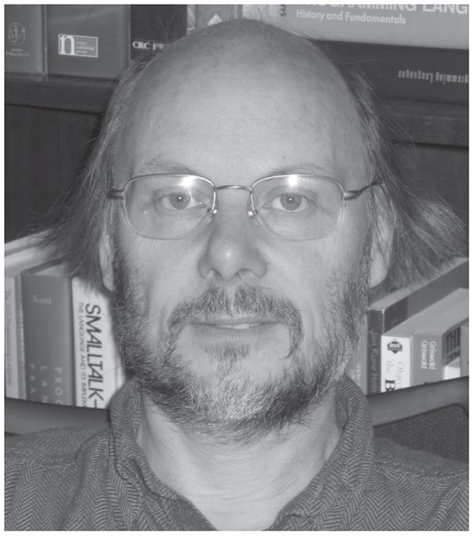
C++: Its Birth, Its Ubiquitousness, and Common Criticisms B J A R N E S T R O U S T R U P

